Slide 1
BLOCKCHAIN BASED LAND REGISTRY SYSTEM

Slide 2
OUR TEAM
Team Leader : Karan Shah
Team Member 1 : Mitiksha Pipaliya
Team Member 2 : Jinal Vanodia
Team Member 3 :Dev Parmar
Team Member 4: Happy Singh Chundawat
Team Member 5: Jay Mehta
Team Member 6: Parva Solanki
Team Member 7: Paras Prajapati

Slide 3
PROBLEM DESCRIPTION
Design and development of Blockchain based land registry system to remove the role of broker and make a more smooth, transparent and secured System.

Slide 4
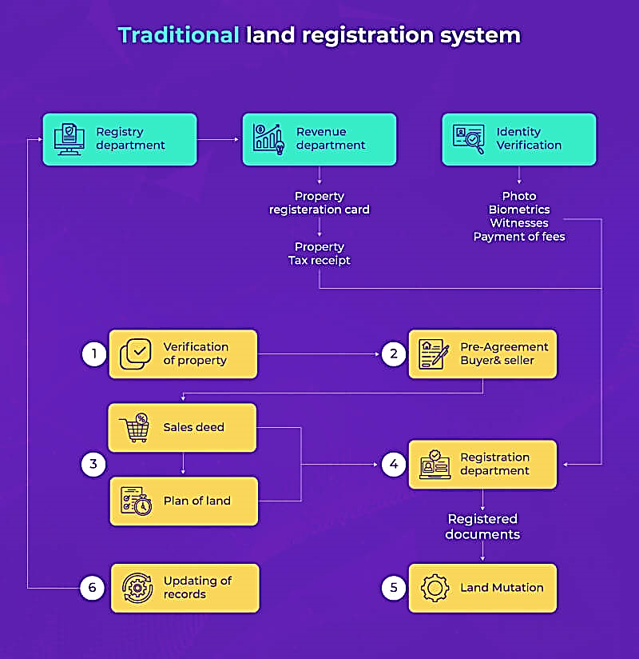

Slide 5
Complex and Fragmented System
Lack of Transparency
PROBLEMS WITH TRADITIONAL APPROACH
Forgery and Fraud
Lack of Digitization
Manual Record-Keeping
Long Registration Processes
Land Title Disputes

Slide 6
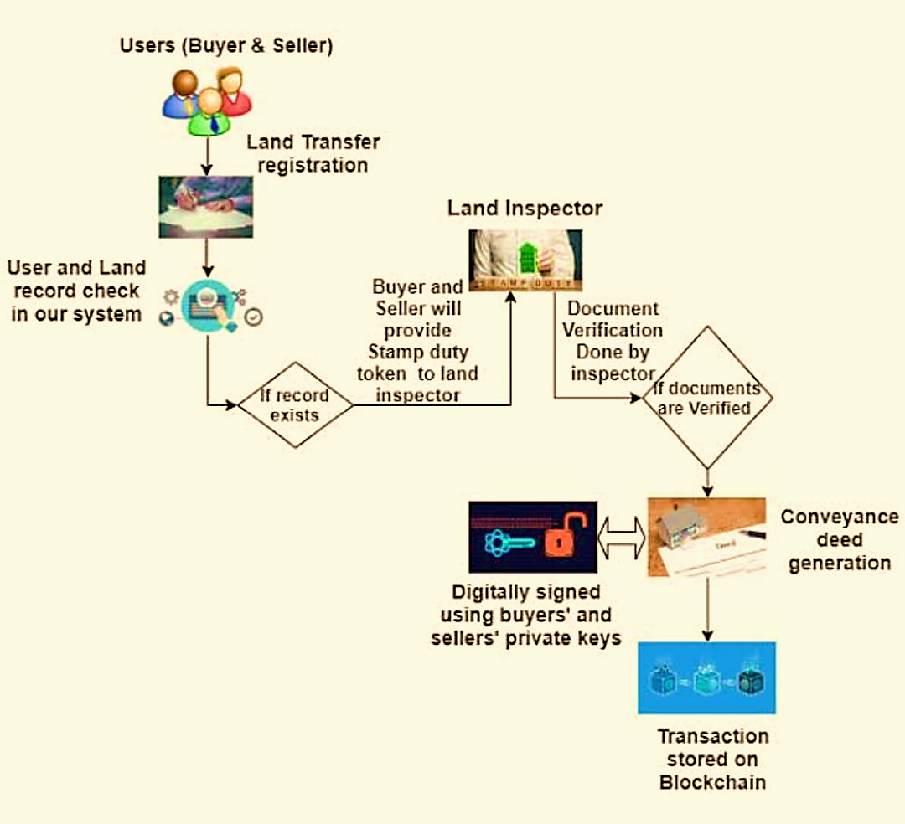
BLOCKCHAIN APPROACH

Slide 7
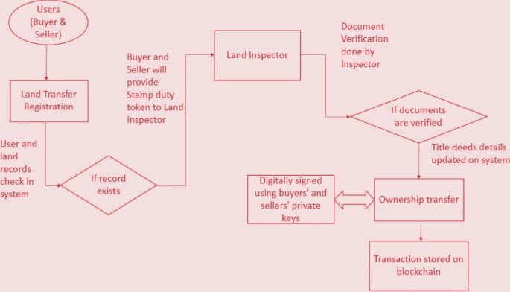
SYSTEM EXECUTION FLOW

Slide 8
Increased Transparency
Enhanced Security
Reduced Fraud and Disputes
Streamlined Transactions
Improved Accessibility
Cost Savings
Global Accessibility
Decentralization of Governance
Scalability and Future-Proofing
BENEFITS

Slide 9
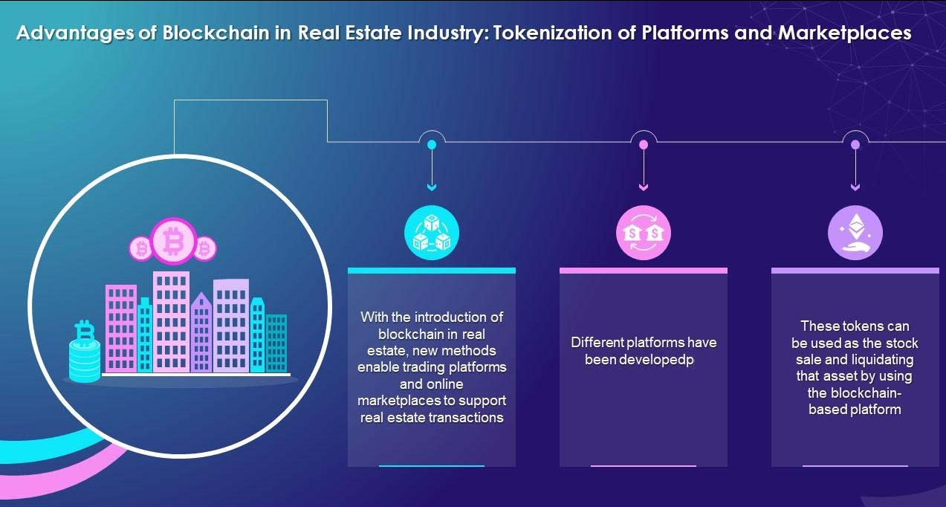

Slide 10
POSSIBLE OUTCOMES
The availability of data in a central location that can be accessed by all departments would enable faster disposal of requests for subsidy, mutation.
There would be no need for trusted authority like notaries to provide attested copies of documents.
The farmers will be assured that their land ownership cannot be changed by spurious persons.

Slide 11
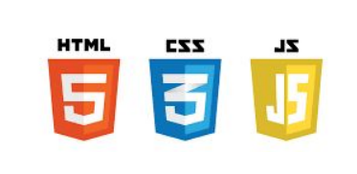


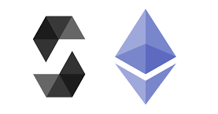

REQUIREMENTS
Ethereum, Solidity, HTML, CSS, Javascript, Truffle, Ganache, Metamask, Oracles, Geospatial and GIS Integration, User Interfaces (UI) and User Experience (UX) Design Tools, Blockchain Explorer

